Slide 1
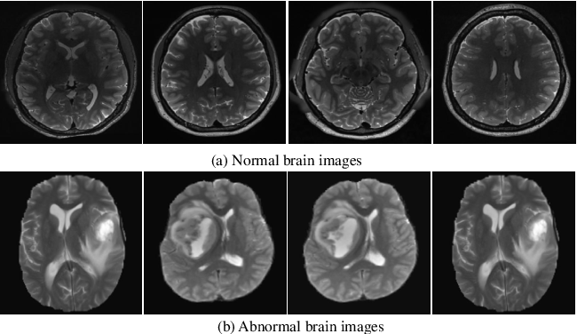
Anomaly Detection in Brain MRI
An overview
10 / 04 / 2024
Notes:
Slide 1: Título
Título: "Anomaly Detection in Brain MRI: Una Revisión de los Últimos Avances"
Subtítulo: "Explorando Algoritmos y Herramientas Innovadoras"
Slide 2: Introducción
Breve introducción al tema.
Justificación de la importancia de la detección de anomalías en imágenes de resonancia magnética cerebral (MRI).
Slide 3: Objetivos de la Presentación
Enumerar los objetivos que cubrirá la presentación.
Slide 4: Contexto
Resumen del estado actual de la detección de anomalías en MRI cerebral.
Estadísticas sobre la prevalencia de enfermedades cerebrales y la importancia de la detección temprana.
Slide 5: Métodos Tradicionales
Breve descripción de métodos tradicionales utilizados anteriormente en la detección de anomalías en MRI cerebral.
Slide 6-10: Algoritmos Modernos
Slide para cada algoritmo moderno relevante.
Nombre del algoritmo.
Principios de funcionamiento.
Ejemplos de aplicación.
Ventajas y limitaciones.
Gráficos o imágenes que ayuden a entender el funcionamiento.
Slide 11: Herramientas Utilizadas
Descripción de las herramientas computacionales y de software utilizadas en la implementación de estos algoritmos.
Slide 12: Desafíos y Limitaciones
Reconocimiento de los desafíos actuales y limitaciones en la detección de anomalías en MRI cerebral.
Slide 13: Avances Recientes
Destacar investigaciones recientes o avances significativos en el campo.
Slide 14: Aplicaciones Prácticas
Ejemplos de aplicaciones prácticas de la detección de anomalías en la práctica clínica.
Slide 15: Casos de Éxito
Resumen de casos de éxito utilizando los algoritmos revisados.
Slide 16: Futuras Direcciones
Mencionar posibles áreas de investigación futuras y desarrollos en la detección de anomalías en MRI cerebral.
Slide 17: Conclusiones
Resumen de los puntos clave cubiertos en la presentación.
Slide 18: Preguntas y Respuestas
Invitar a la audiencia a hacer preguntas.
Slide 19: Agradecimientos
Agradecimiento a la audiencia y posiblemente a patrocinadores o colaboradores.
Slide 20: Información de Contacto
Tu nombre, afiliación y detalles de contacto para consultas adicionales.
Recuerda utilizar gráficos, tablas e imágenes pertinentes en cada diapositiva para hacer la presentación visualmente atractiva y fácil de entender. ¡Buena suerte con tu presentación!

Slide 2
Anomaly Detection in Brain MRI
0
Setting the stage

Slide 3
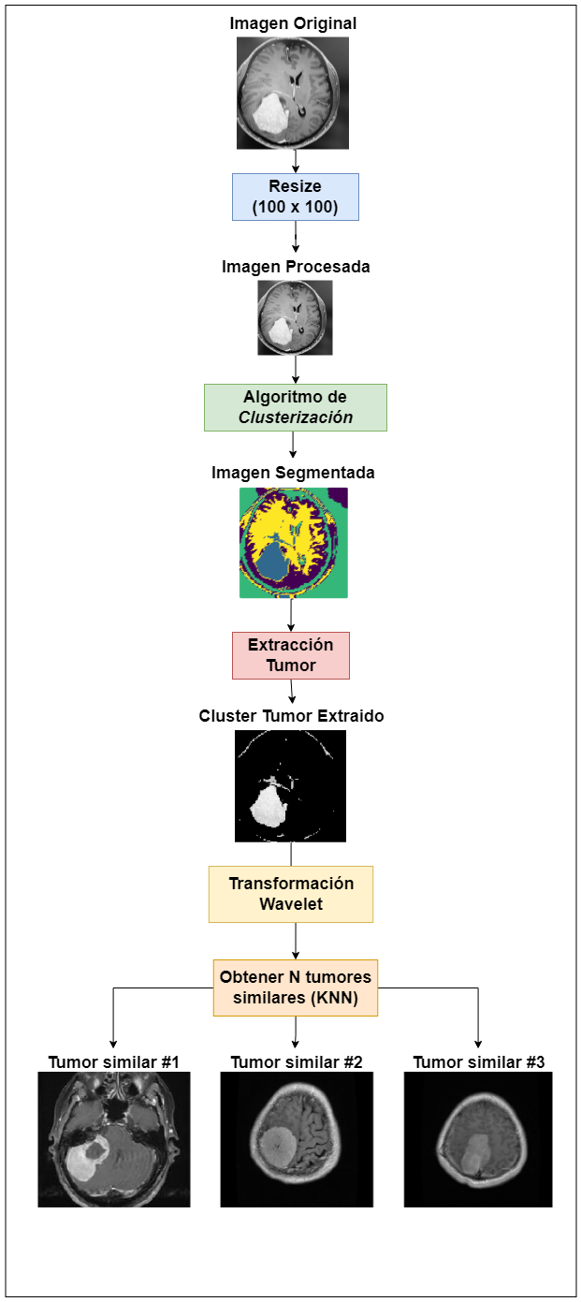

Anomaly Detection in Brain MRI
In ML course …
We implement basic clustering algorithms (Kmeans, DBScan, GMM).
We applied basic ML algorithm to segment brain image dataset.
We segment the image and manually target the anomalies (tumors)
We separate the anomalies in a new image and apply a wavelet transformation (to vectors).
Finally, we index the image representation (vectors) in a data structure to find KNN.
Source

Slide 4
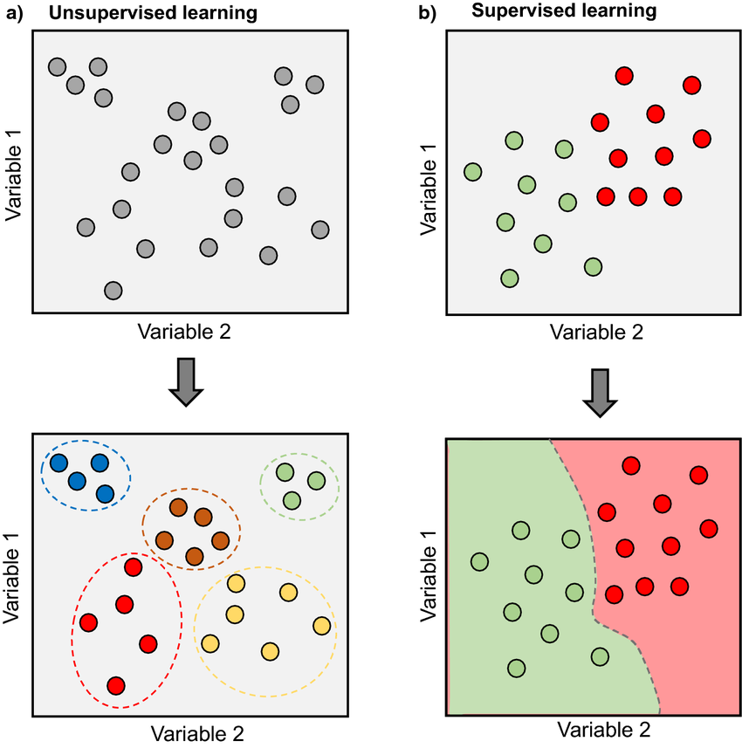
Anomaly Detection in Brain MRI

Slide 5
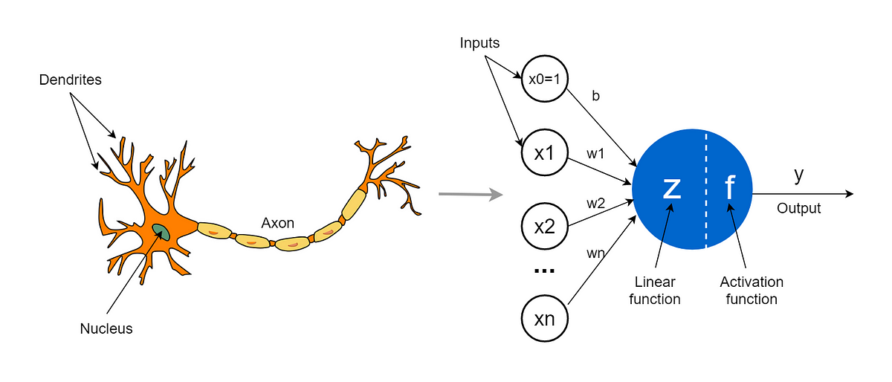
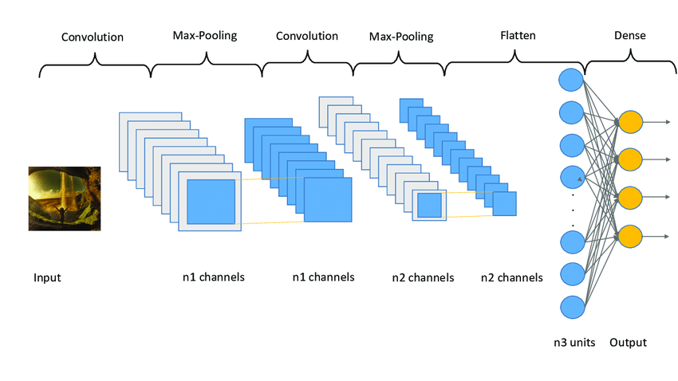
Anomaly Detection in Brain MRI
Key concepts
Neural network basic concepts
Linear Regression (perceptron)
Forward/ Back Propagation
Deep Learning Architectures
Autoencoders
Convolutional Neural Networks
CNN
Convolution (deconvolution)
Pooling (unpooling)
Notes:
Images prompts:
perceptron vs. neural network
convolutional neural network

Slide 6
Anomaly Detection in Brain MRI
Timeline
Inserta texto aquí
Inserta texto aquí
Inserta texto aquí
Inserta texto aquí
Inserta texto aquí
Inserta texto aquí
XXXX
XXXX
XXXX
XXXX
XXXX
Inserta texto aquí
Inserta texto aquí
Inserta texto aquí
Inserta texto aquí

Slide 7
Anomaly Detection in Brain MRI
Contents
Introduction
Problem definition
History
Key concepts
Traditional methods
Modern algorithms
Demo

Slide 8
Anomaly Detection in Brain MRI
1
Introduction

Slide 9
Anomaly Detection in Brain MRI
2
Problem definition

Slide 10
Anomaly Detection in Brain MRI
Anomaly detection
CONTEXT:
MR imaging of the brain is at the heart of diagnosis and treatment of neurological diseases.
I/O: classification/segmentation map/residual map

Slide 11
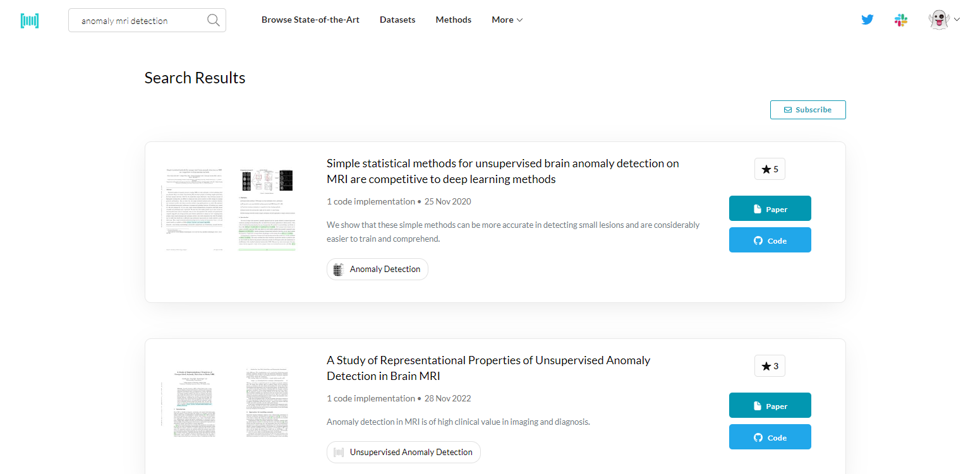
Anomaly Detection in Brain MRI

Slide 12
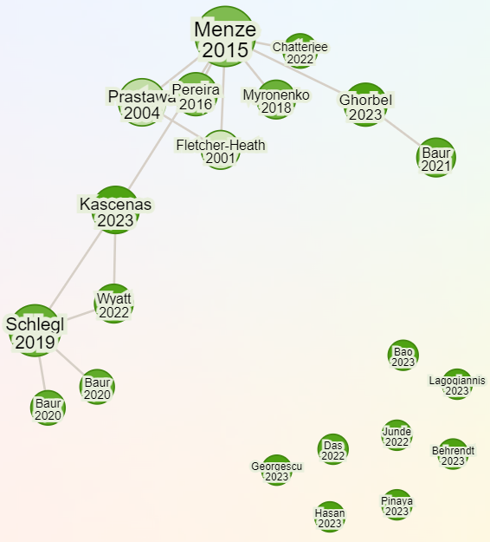

Anomaly Detection in Brain MRI
Research
Rabbit

Slide 13
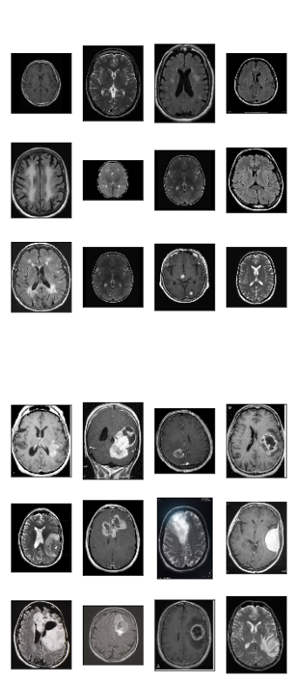
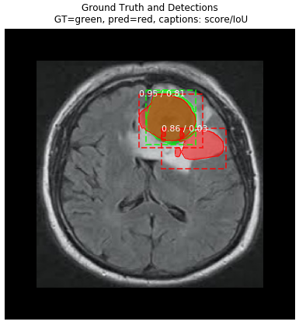

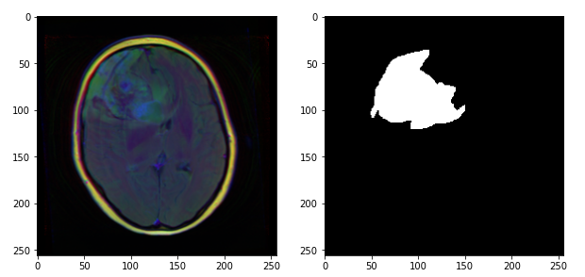
Anomaly Detection in Brain MRI
Main approaches
Main approaches are based on supervised deep learning (classification, semantic segmentation, object detection) to detect tumors or lesions arising from neurogenerative-disease like Alzheimer or MS(multiple sclerosis)
Supervised learning carry some disadvantages
Annotated datasets are scarce, costly to obtain
Reading and interpreting MRI scans is an intricate process: It is estimated that in 5-10% of scans, a relevant pathology is missed.
The resulting models are limited to the discovery of lesions which are similar to the training data (don’t cover all the domain like rare diseases)
Notes:
https://www.kaggle.com/code/ruslankl/brain-tumor-detection-v1-0-cnn-vgg-16
https://www.kaggle.com/code/mahmoudlimam/brain-mri-segmentation
https://www.kaggle.com/code/ruslankl/brain-tumor-detection-v2-0-mask-r-cnn

Slide 14
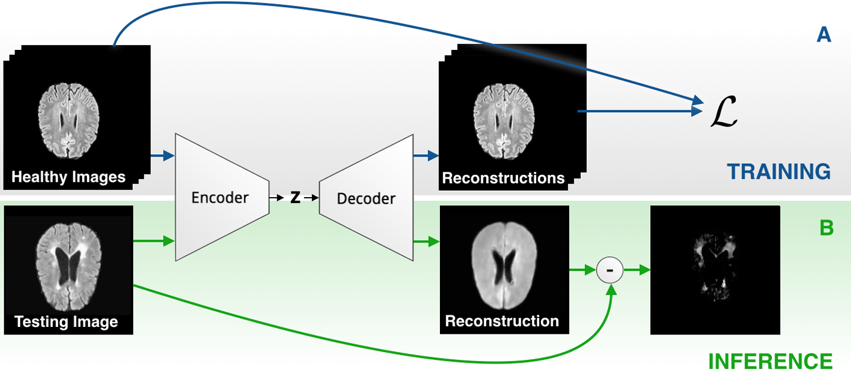
Anomaly Detection in Brain MRI
Unsupervised approach
Unsupervised Anomaly Detection (UAD) have the potential to detect arbitrary anomalies without a-priori knowing about the lesions appearances.
Traditional methods are based on statistical modeling, content-based retrieval, clustering or outlier-detection.
Recently works use neural networks to solve a clustering task.
The underlying idea thereby is to model the distribution of healthy anatomy of the human brain with the help of deep (generative) representation learning. Once trained, anomalies can be detected as outliers from the modeled, normative distribution.
Autoencoders (AE) with their ability to learn non-linear transformations of data onto a low dimensional manifold are widely used.

Slide 15
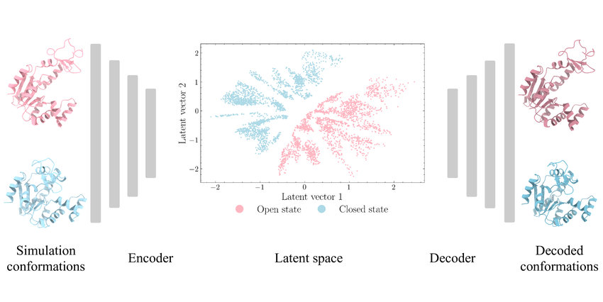
Anomaly Detection in Brain MRI
Autoencoders
AEs and their generative siblings (VAE, GAN, GMVAE, VAEGAN) have emerged as a popular framework to achieve this by essentially learning to compress and reconstruct MR data of healthy anatomy.

Slide 16
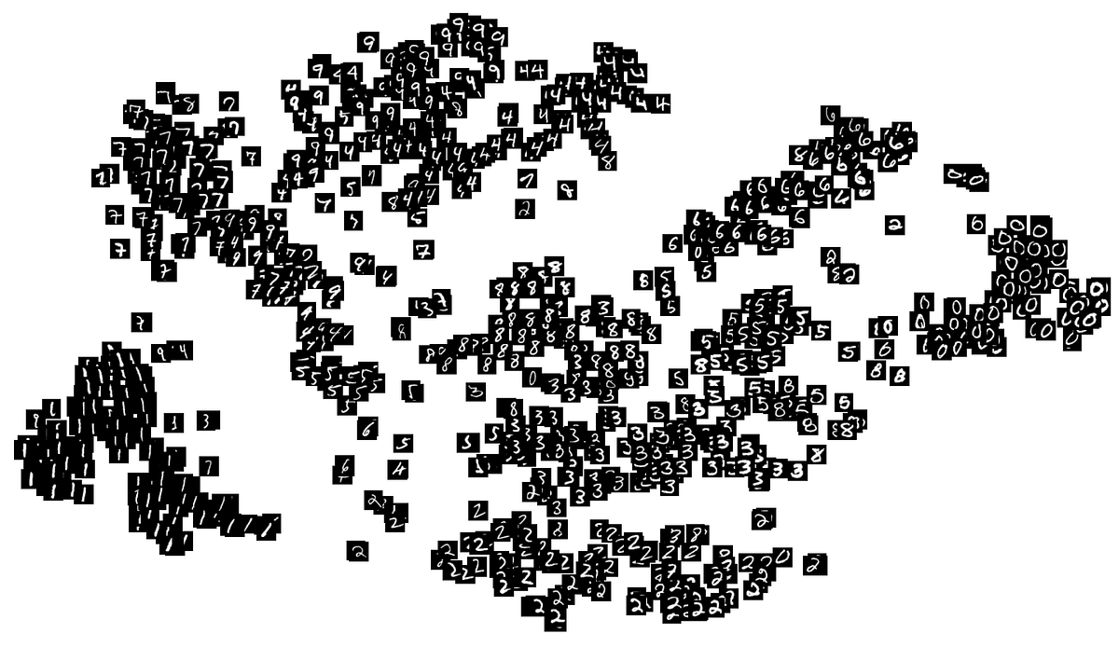

Anomaly Detection in Brain MRI
Latent space/Latent variable/Manifold
Animation
Notes:
https://github.com/gr-b/autoencoder-latent-space-visualization
https://github.com/gonzalorecio/MNIST-latent-representations

Slide 17
Anomaly Detection in Brain MRI
Anomaly detection and segmentation
Notes:
The respective methods can essentially be divided into two categories: 1) Reconstruction-based ap proaches compute a pixel-wise discrepancy between input samples and their feed-forward reconstructions to determine anomalous lesions directly in image-space; 2) Restoration based methods [9][10] try to alter an input image by moving along the latent manifold until a normal counterpart to the input sample is found, which in turn is used again to detect le sions from the pixel-wise discrepancy of the input data and its healthy restoration.
Reconstruction-based
Monte Carlo Methods
Gradient-based
Restoration-based

Slide 18
Anomaly Detection in Brain MRI
4
Datasets

Slide 19
Anomaly Detection in Brain MRI
Dataset | Structure | # Samples
Notes:
Healthy, MS & GB
MSLUB
MSSEG2015

Slide 20
Anomaly Detection in Brain MRI
5
Metrics

Slide 21
Anomaly Detection in Brain MRI
Notes:
Precision-Recall-Curves (PRC)
AUPRC (Area Under)
Operating Point (OP)
DICE-score (DICE)
ROC and AUROC

Slide 22
Anomaly Detection in Brain MRI
6
Paper 1: Autoencoders for Unsupervised Anomaly Segmentation in Brain MR Images: A Comparative Study

Slide 23
Anomaly Detection in Brain MRI
Autoencoders for Unsupervised Anomaly Segmentation in Brain MR Images: A Comparative Study
The intent of this work is to establish comparability among recent methods by utilizing a single architecture, a single resolution and the same dataset(s).
We compare various reconstruction as well as restoration-based methods against each other on a variety of different MR datasets with different pathologies

Slide 24
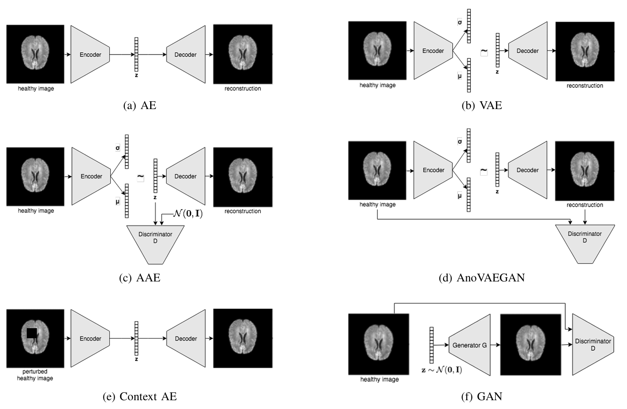
Anomaly Detection in Brain MRI
Implemented architectures

Slide 25
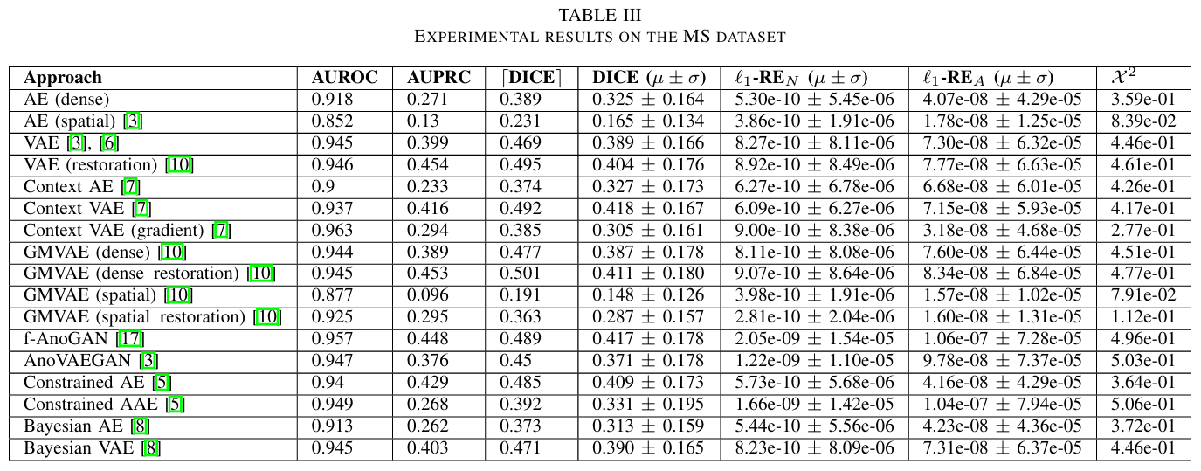
Anomaly Detection in Brain MRI

Slide 26
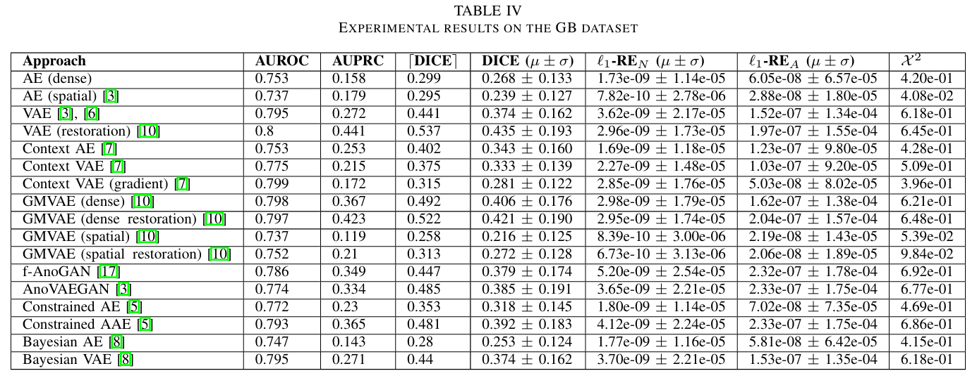
Anomaly Detection in Brain MRI

Slide 27

Anomaly Detection in Brain MRI

Slide 28
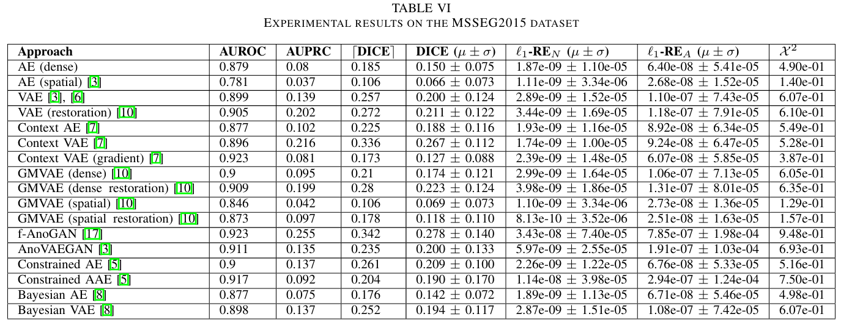
Anomaly Detection in Brain MRI

Slide 29
Anomaly Detection in Brain MRI
7
Demo

Slide 30


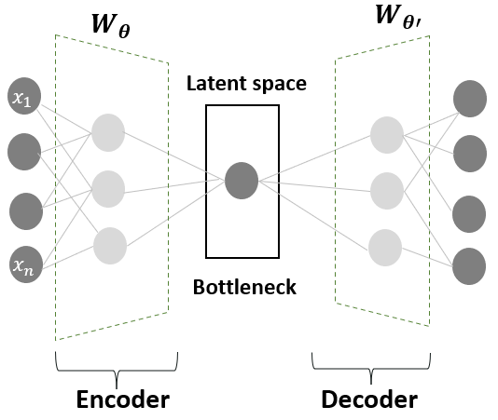
Anomaly Detection in Brain MRI
Autoencoders for Unsupervised Anomaly Segmentation in Brain MR Images: A Comparative Study
Source: GitHub
Environment: LightningAI Studios (free CPU instances, VSCode on the web)
Framework: Tensorflow v1
Observations:
The repository contains the code of _ autoencoder architectures to train and test with the BrainWeb dataset principally
Tensorflow v1 caused problems. I don't have enough RAM to Dockerize the project. But it’s an alternative.
The project doesn’t have .h5/.pickle/.pkl model files to replicate the metrics presented in the document.
The project was executed and some neural networks was trained. However this models do not perform well.
My experience with Tensorflow is little and I need more time to edit the project and load the trained model after saving and try more ideas.
I didn’t use GPU because I obtained errors, it has a cost and I didn’t want to spend too much time debugging.
Replication of results was not achieved.

Slide 31


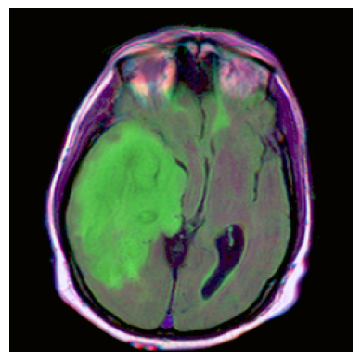

Anomaly Detection in Brain MRI
U-Net: Convolutional Networks for Biomedical Image Segmentation
Source: PyTorchHub/Kaggle
Environment: Google Colab
Framework: PyTorch
Observations:
Supervised learning
“Old” architecture (2015)
No metrics
Notes:
https://pytorch.org/hub/mateuszbuda_brain-segmentation-pytorch_unet/
https://pytorch.org/hub/

Slide 32
Anomaly Detection in Brain MRI
8
Tools

Slide 33
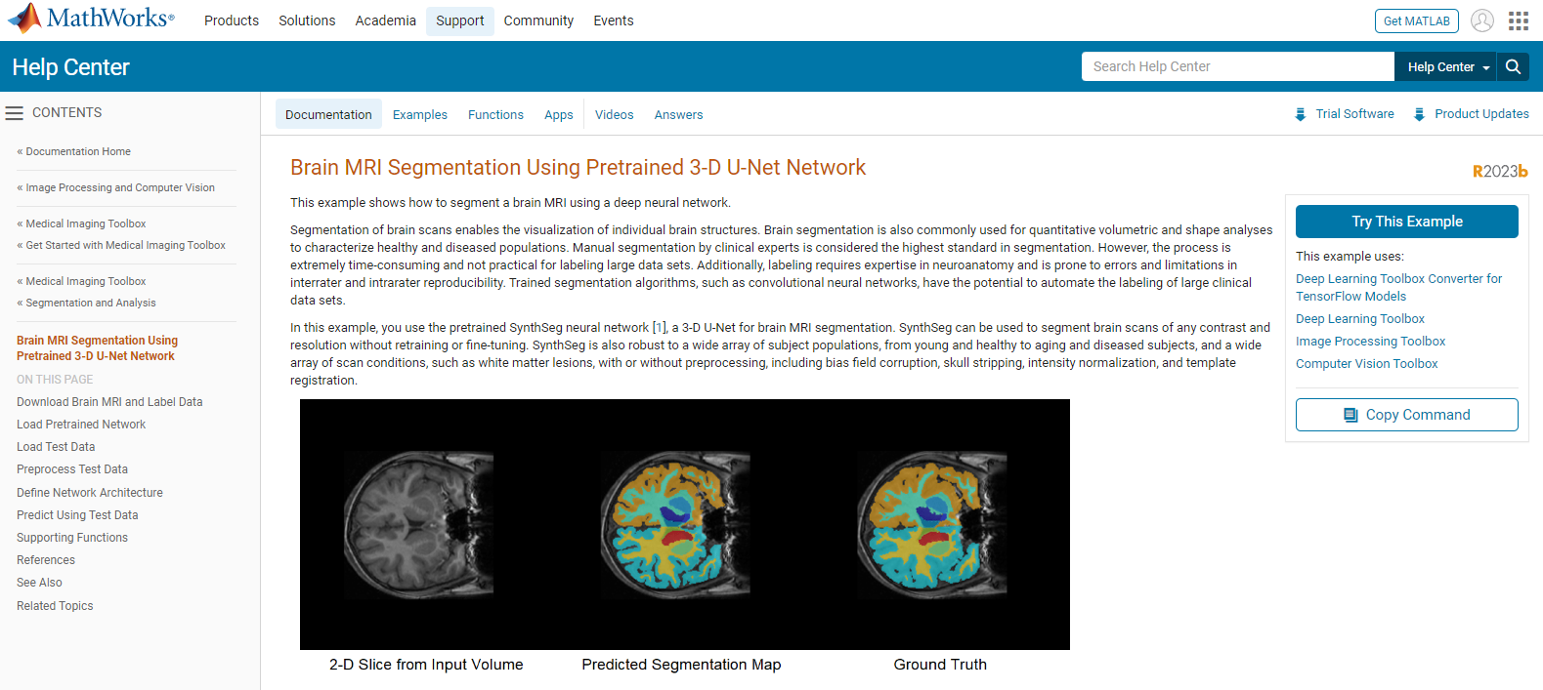
Anomaly Detection in Brain MRI
Notes:
https://www.mathworks.com/help/medical-imaging/ug/Brain-MRI-Segmentation-Using-Trained-3-D-U-Net.html

Slide 34
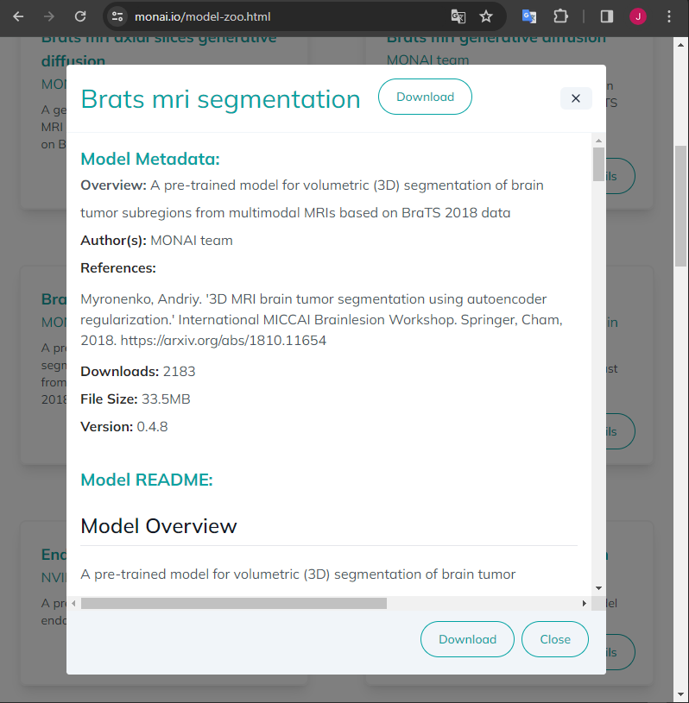
Anomaly Detection in Brain MRI

Slide 35
CS4002 - PFC1
Bibliografía
https://github.com/jeremy-jmc/CS4002-PFC1/tree/main
U-Net: Convolutional Networks for Biomedical Image Segmentation
Patched Diffusion Models for Unsupervised Anomaly Detection in Brain MRI https://arxiv.org/pdf/2303.03758.pdf
Denoising Autoencoders for Unsupervised Anomaly Detection in Brain MRI https://proceedings.mlr.press/v172/kascenas22a/kascenas22a.pdf
Transformer based Models for Unsupervised Anomaly Segmentation in Brain MR Images https://arxiv.org/pdf/2207.02059.pdf
https://github.com/ahmedgh970/Transformers_Unsupervised_Anomaly_Segmentation

Slide 36

TY!

Slide 37
Anomaly Detection in Brain MRI

Slide 38
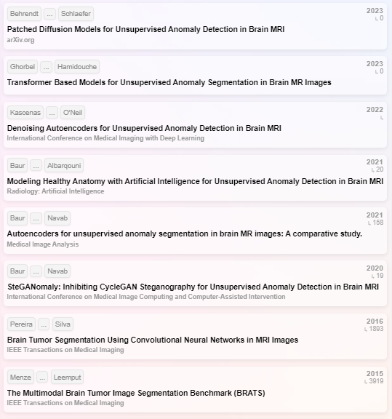

Paper
GitHub
Implem.
Conference/
https://arxiv.org/pdf/2303.03758.pdf | https://github.com/FinnBehrendt/patched-Diffusion-Models-UAD/tree/main
https://link.springer.com/chapter/10.1007/978-3-031-33842-7_3 | https://github.com/ahmedgh970/Transformers_Unsupervised_Anomaly_Segmentation/tree/main | 2207.02059.pdf (arxiv.org)
https://proceedings.mlr.press/v172/kascenas22a.html | https://github.com/AntanasKascenas/DenoisingAE/tree/master
https://arxiv.org/pdf/2004.03271.pdf | https://github.com/StefanDenn3r/Unsupervised_Anomaly_Detection_Brain_MRI | XXXXXXXXXXXXXXXXXXXXXXXXXXXXXXXXXXXXXXXXXXXXXXXXXXXXXXXXXXXXXXXXXXXX
Research
Rabbit

